Slide 1
V – Genetic diagnostic technologies

Slide 2
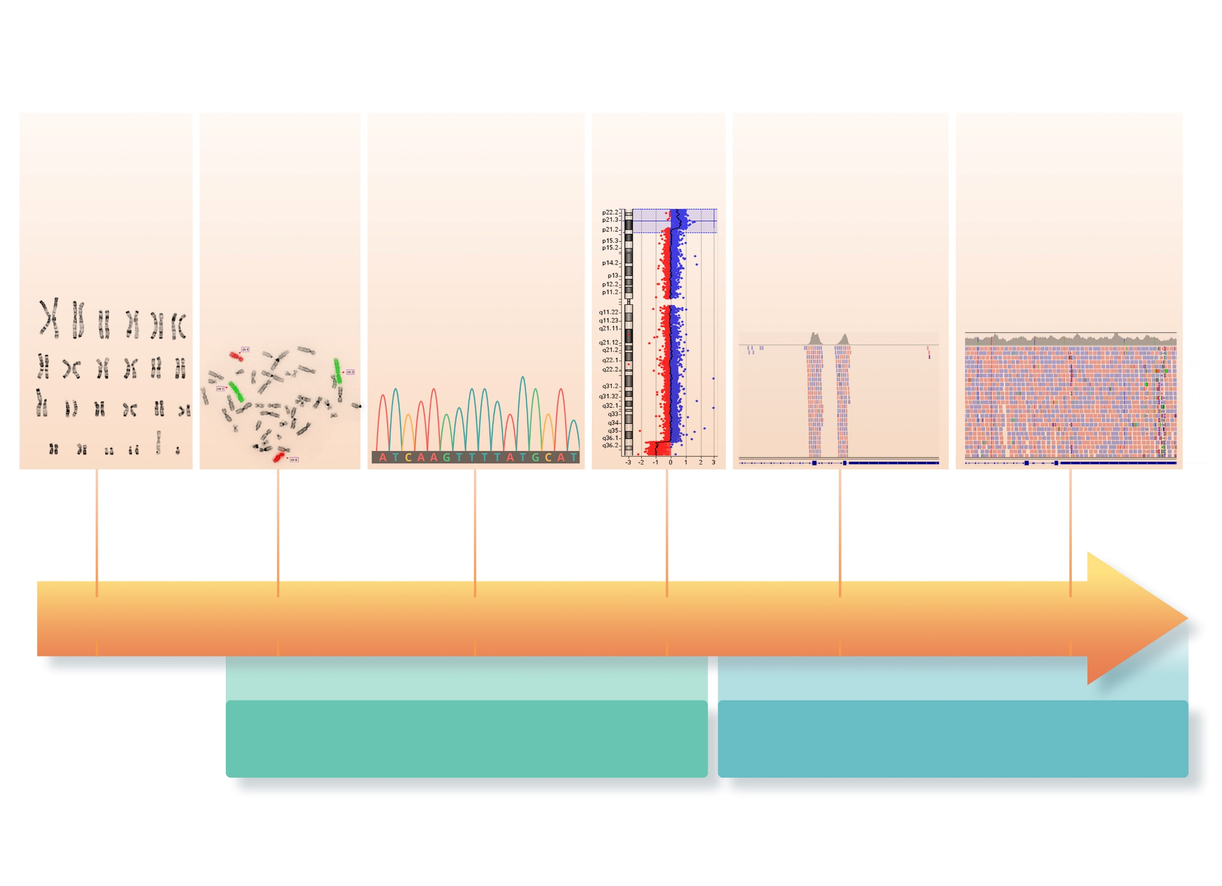
71 - Technological developments

Slide 3
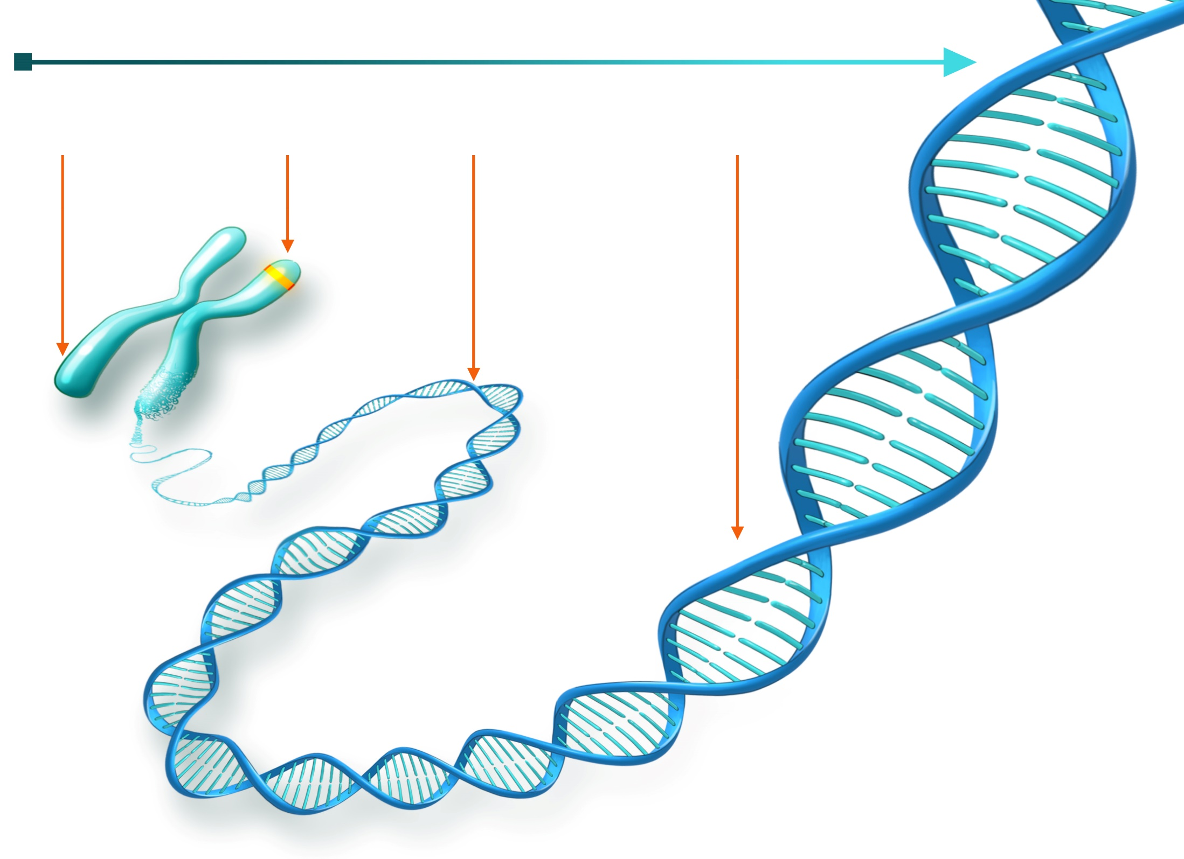
72 - From chromosome to DNA

Slide 4
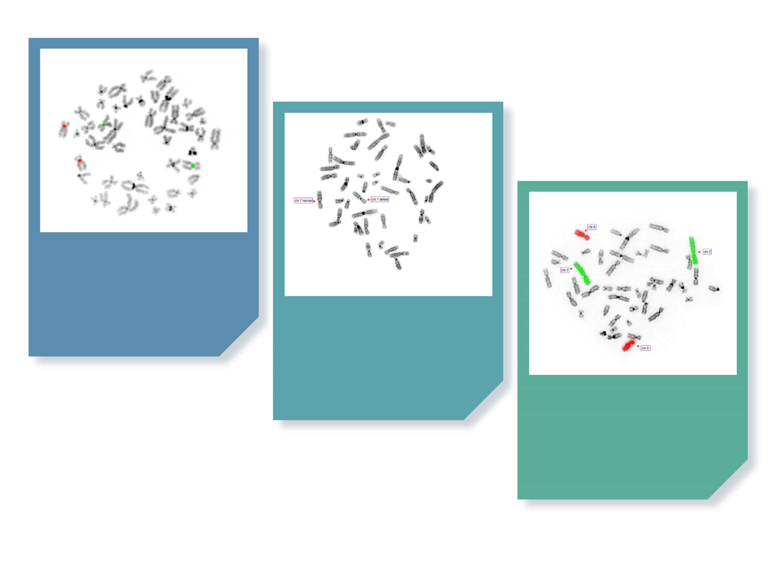
73 - Different types of FISH

Slide 5
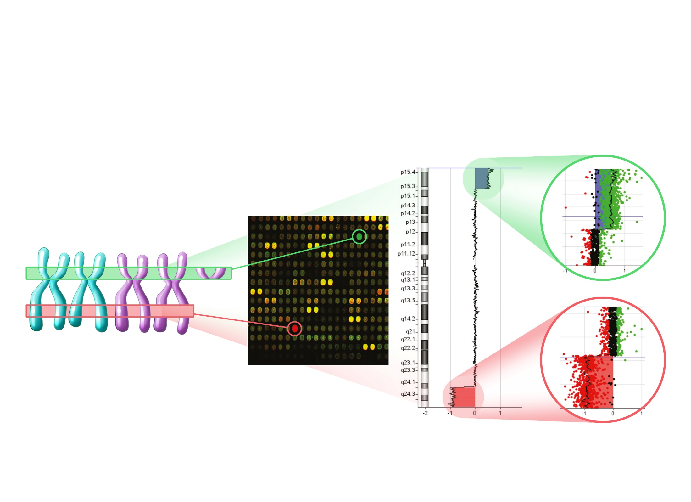
74 – Array-CGH or chromosomal analysis by DNA microarray

Slide 6
75 - A film to explain high-throughput sequencing

Slide 7
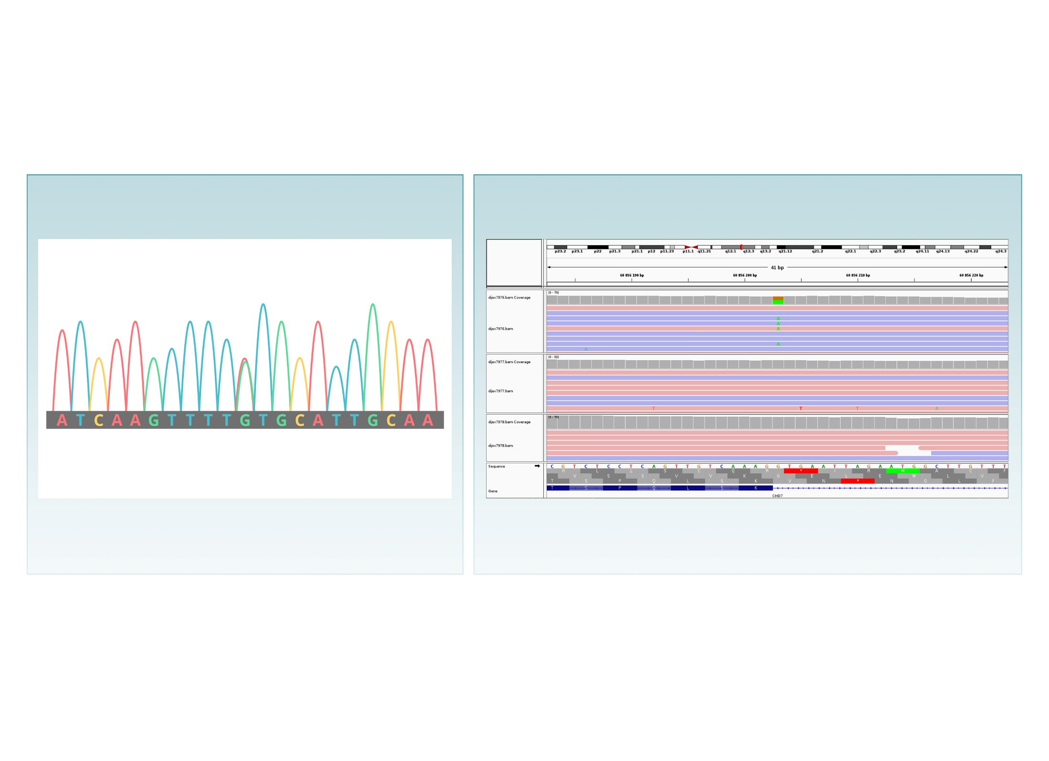
76 - Visualization of variants

Slide 8
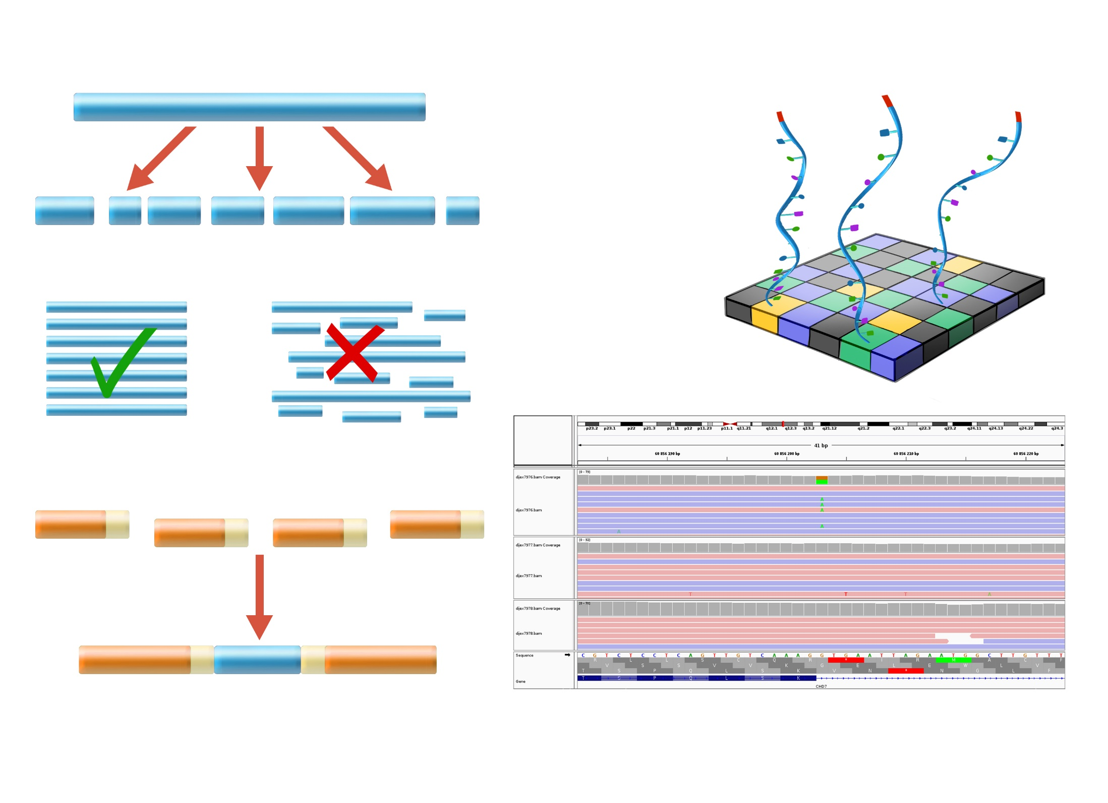
77 - Principle of exome sequencing

Slide 9
78 - Exome: bioinformatic data analysis
Notes:
Mots clés : Analyse Bioinformatique, Exome, Variations, Interprétation

Slide 10
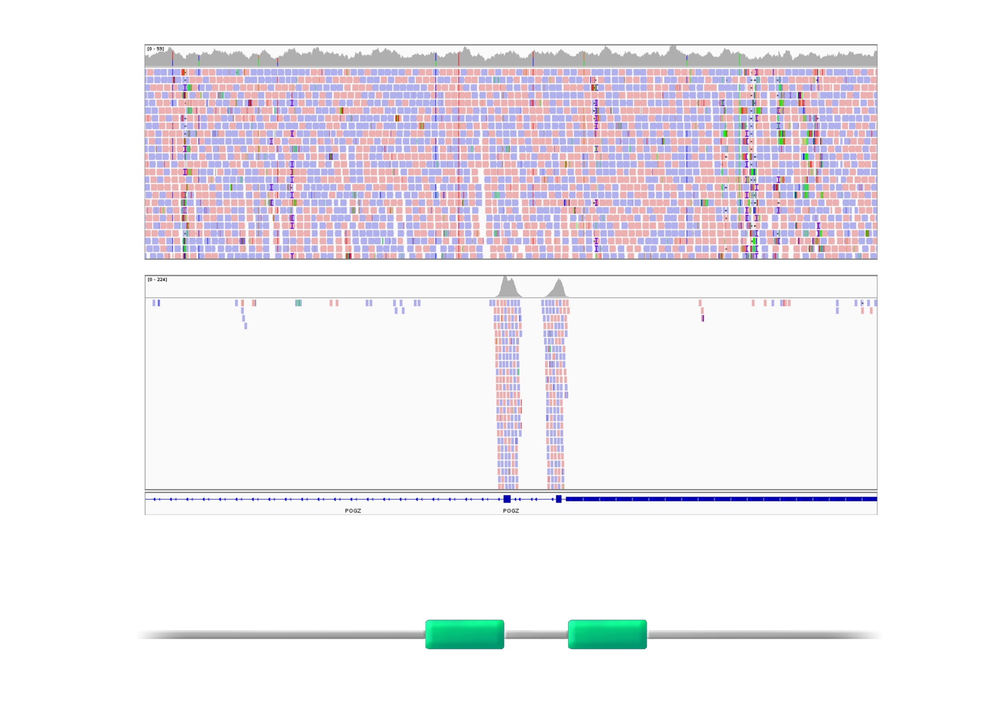
79 – Génome analysis

Slide 11
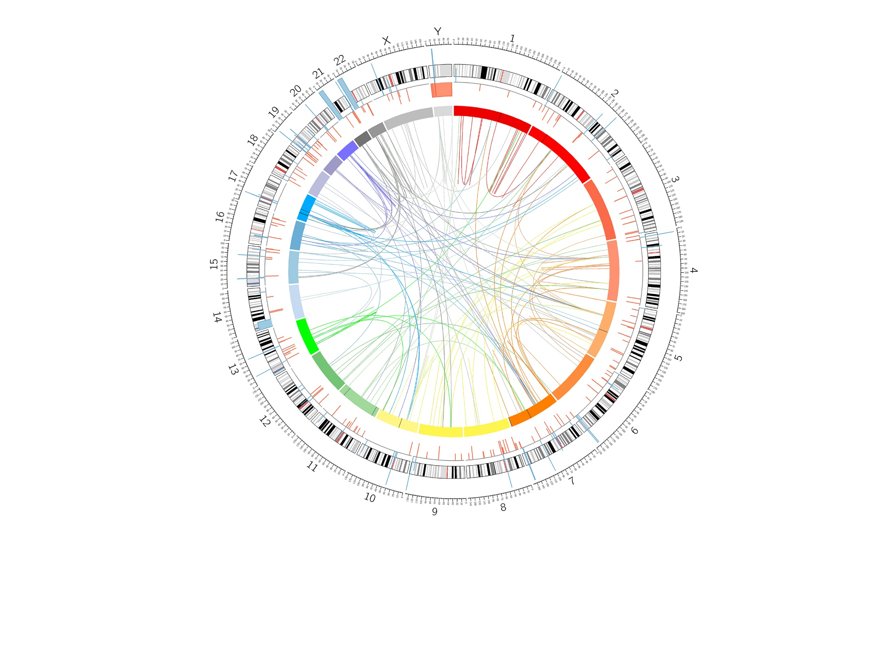
80 - Structural anomalies detected by genome
Notes:
Mots clés : Anomalie de structure, Génome, Chromotrypsis
Image à fournir

Slide 12
81 - Differents Omics
Notes:
Mots clés : Omics, Multiomics, RNAseq, Epigénétique, Protéome

Slide 13
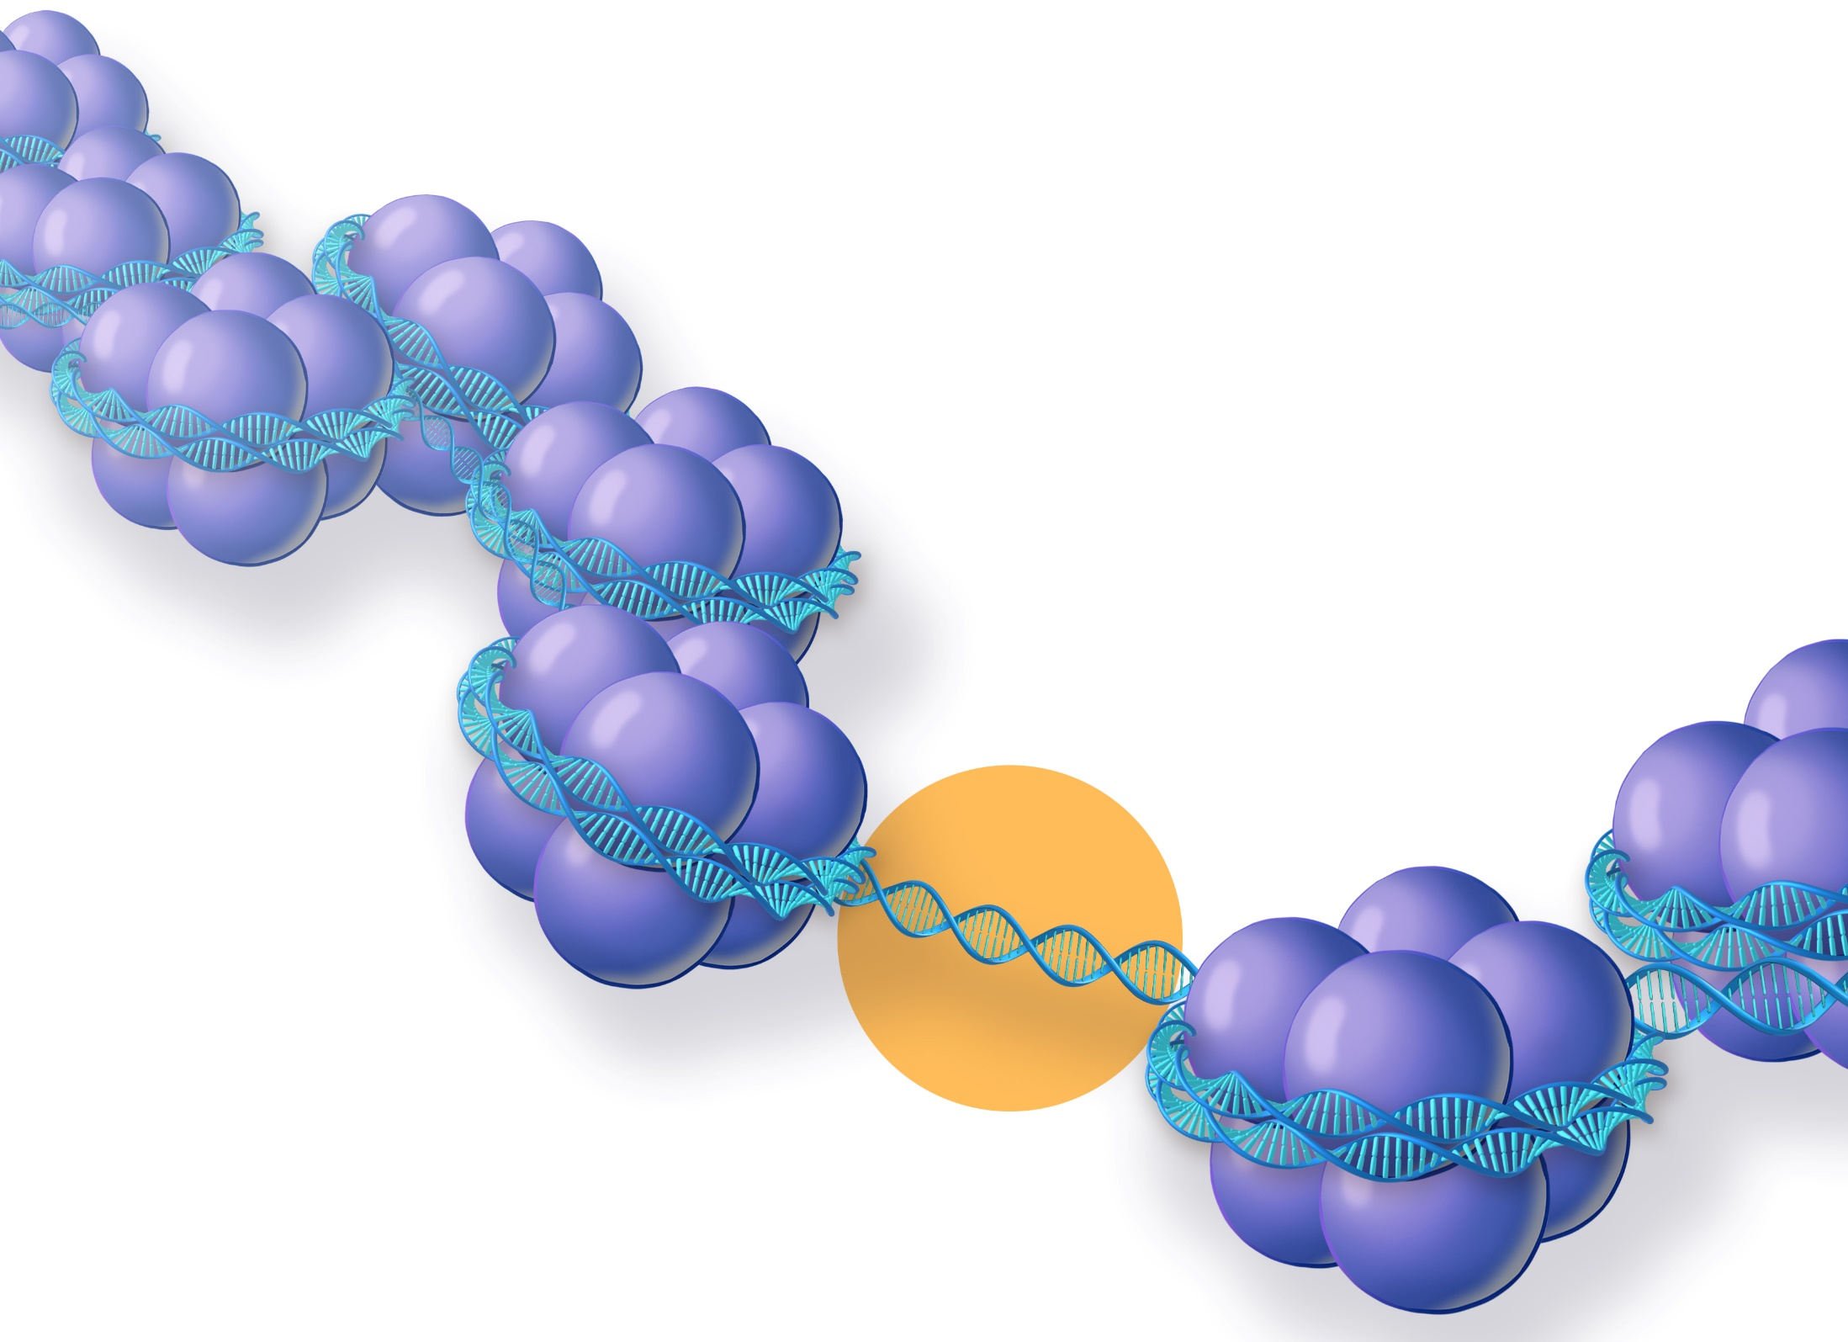
82 - The epigenome

Slide 14
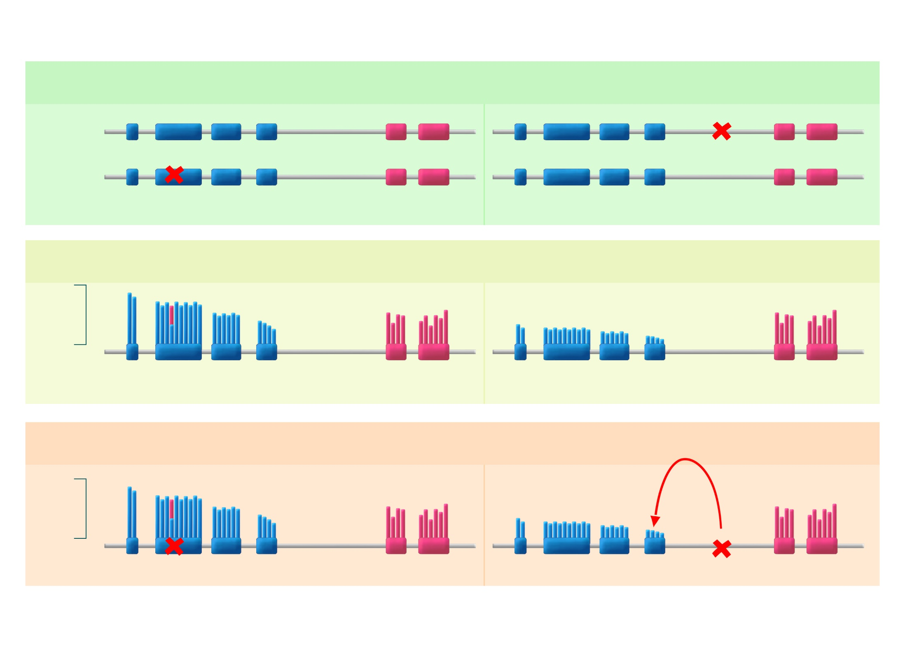
83 - Integrated analyses
Notes:
Mots clés : Analyses intégrées, WGS, RNAseq, OMICs, combinaison, technique
Exon 1
Intron 1

Slide 15
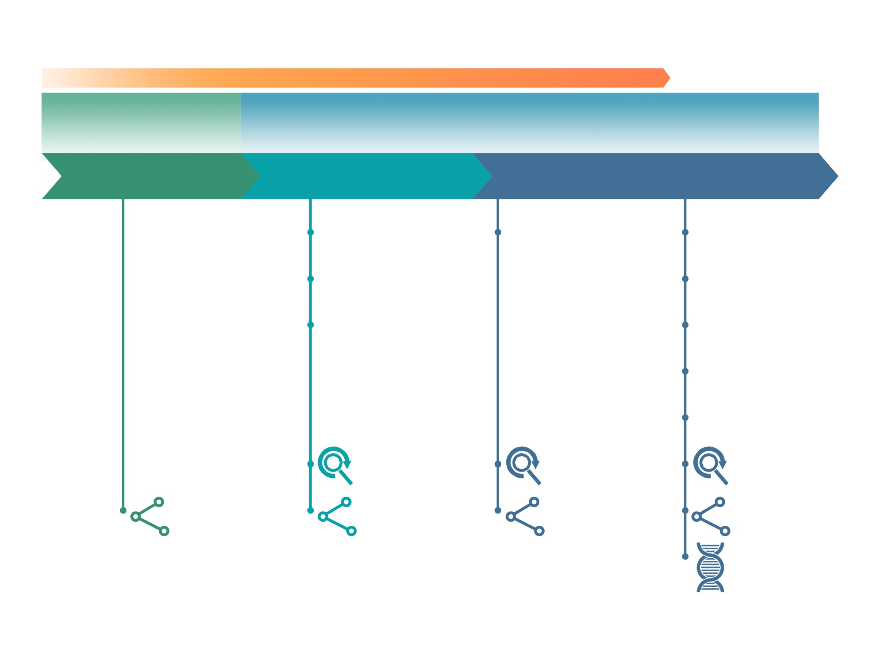
84 - Advantages and disadvantages of different sequencing technologies
Notes:
Mots clés : séquençage, techniques, avantages, inconvénients, OMICS

Slide 16
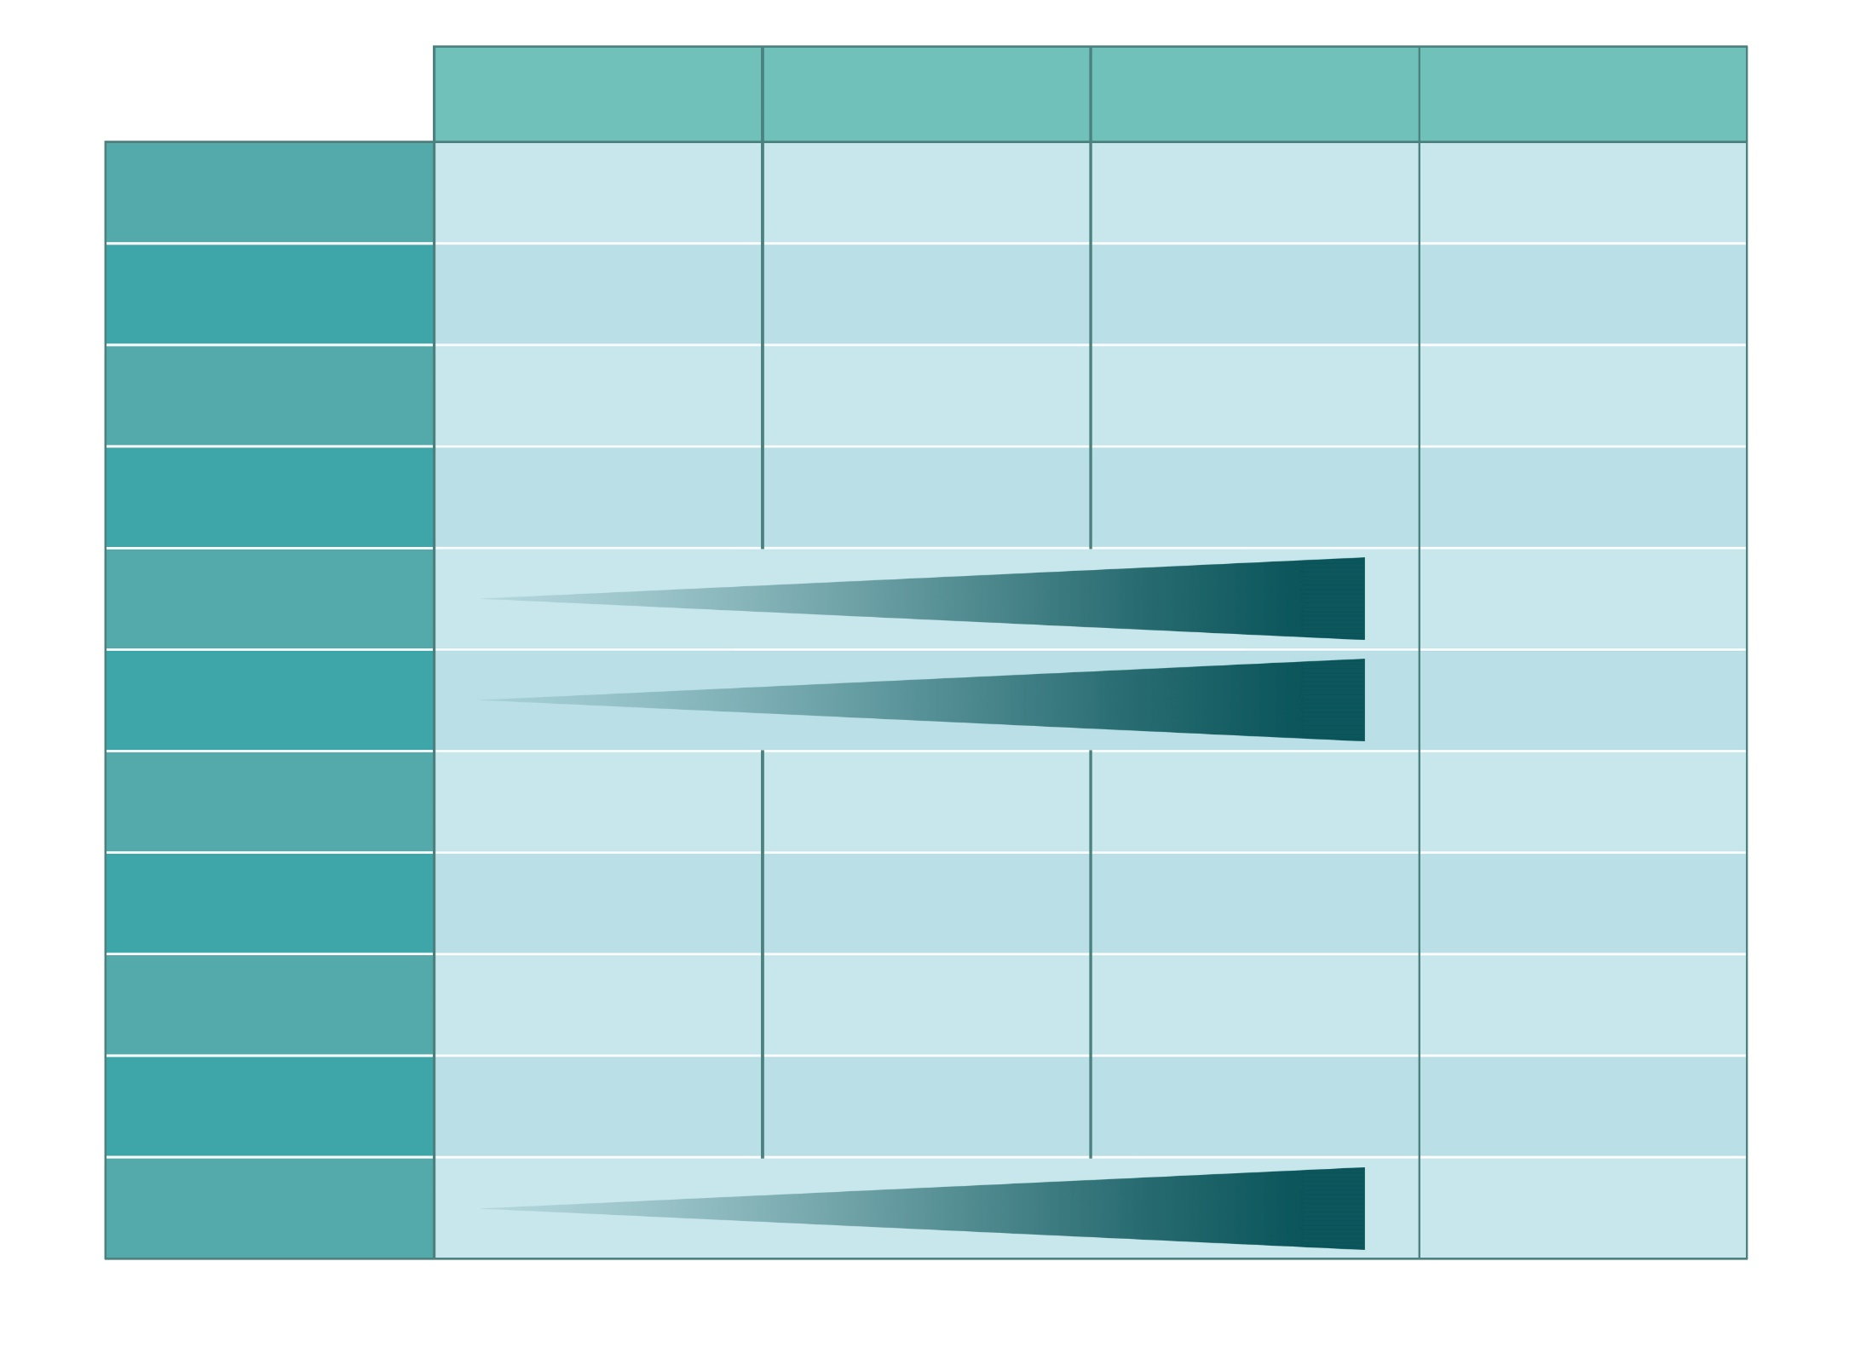
85 - Advantages and disadvantages of different sequencing techniques
Notes:
Mots clés : Avantages, Inconvénients, Comparaison, Panel, NGS, SHD, Tableau

